Slide 1

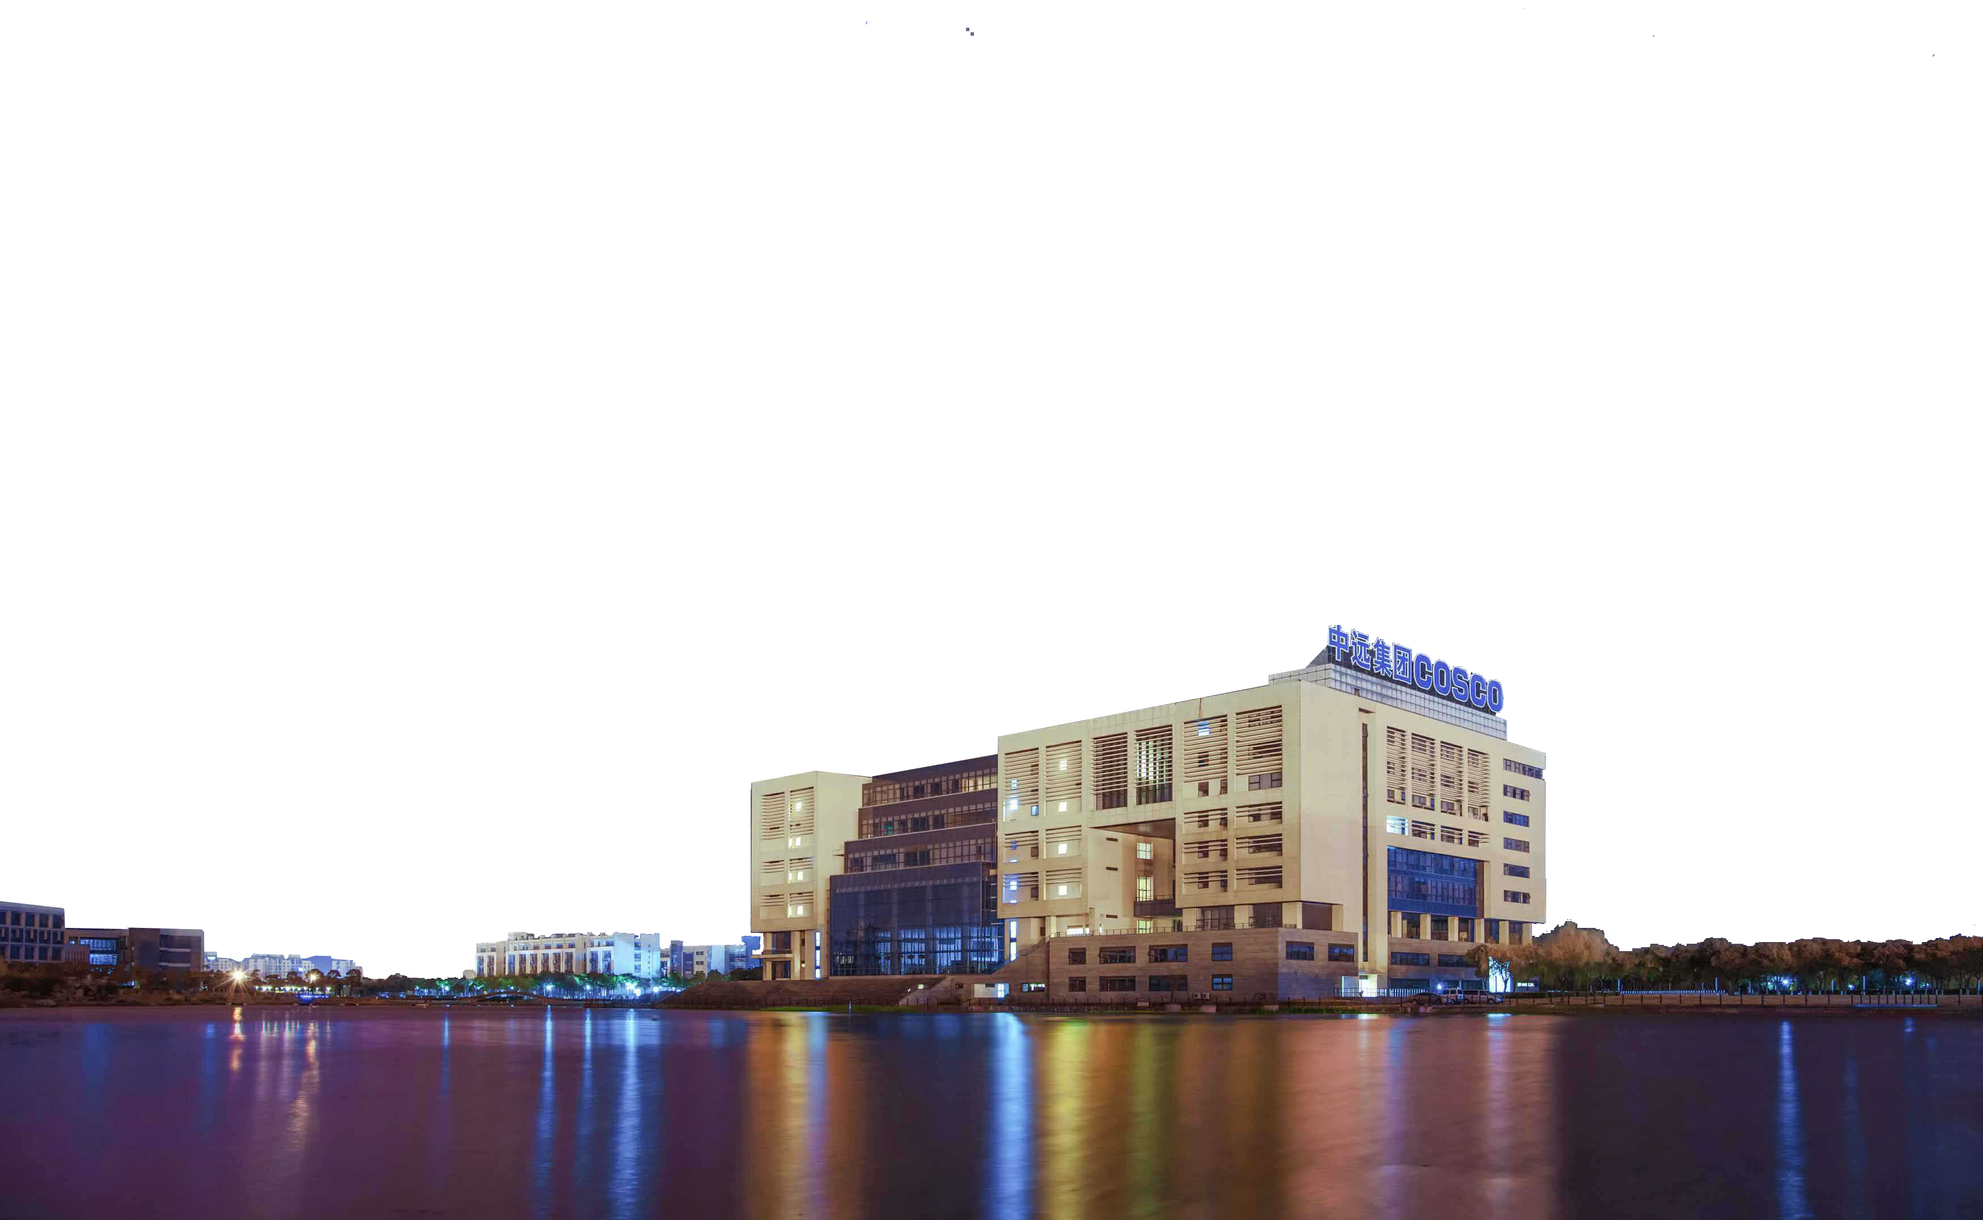
Smart Seat
Date：2019-03-18
Represented by：Hanyu Zhang
Detail design
representation

Slide 2
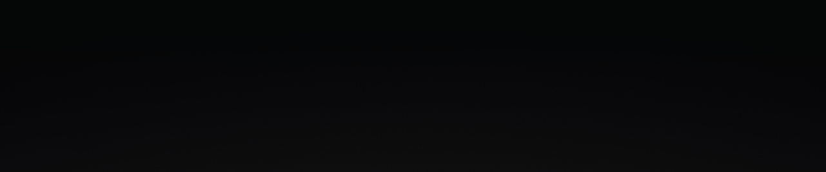
CONTENTS
Part I
Part II
Part III
Part IV
Purpose
ConceptDisplay
Summary Design
Details Design

Slide 3
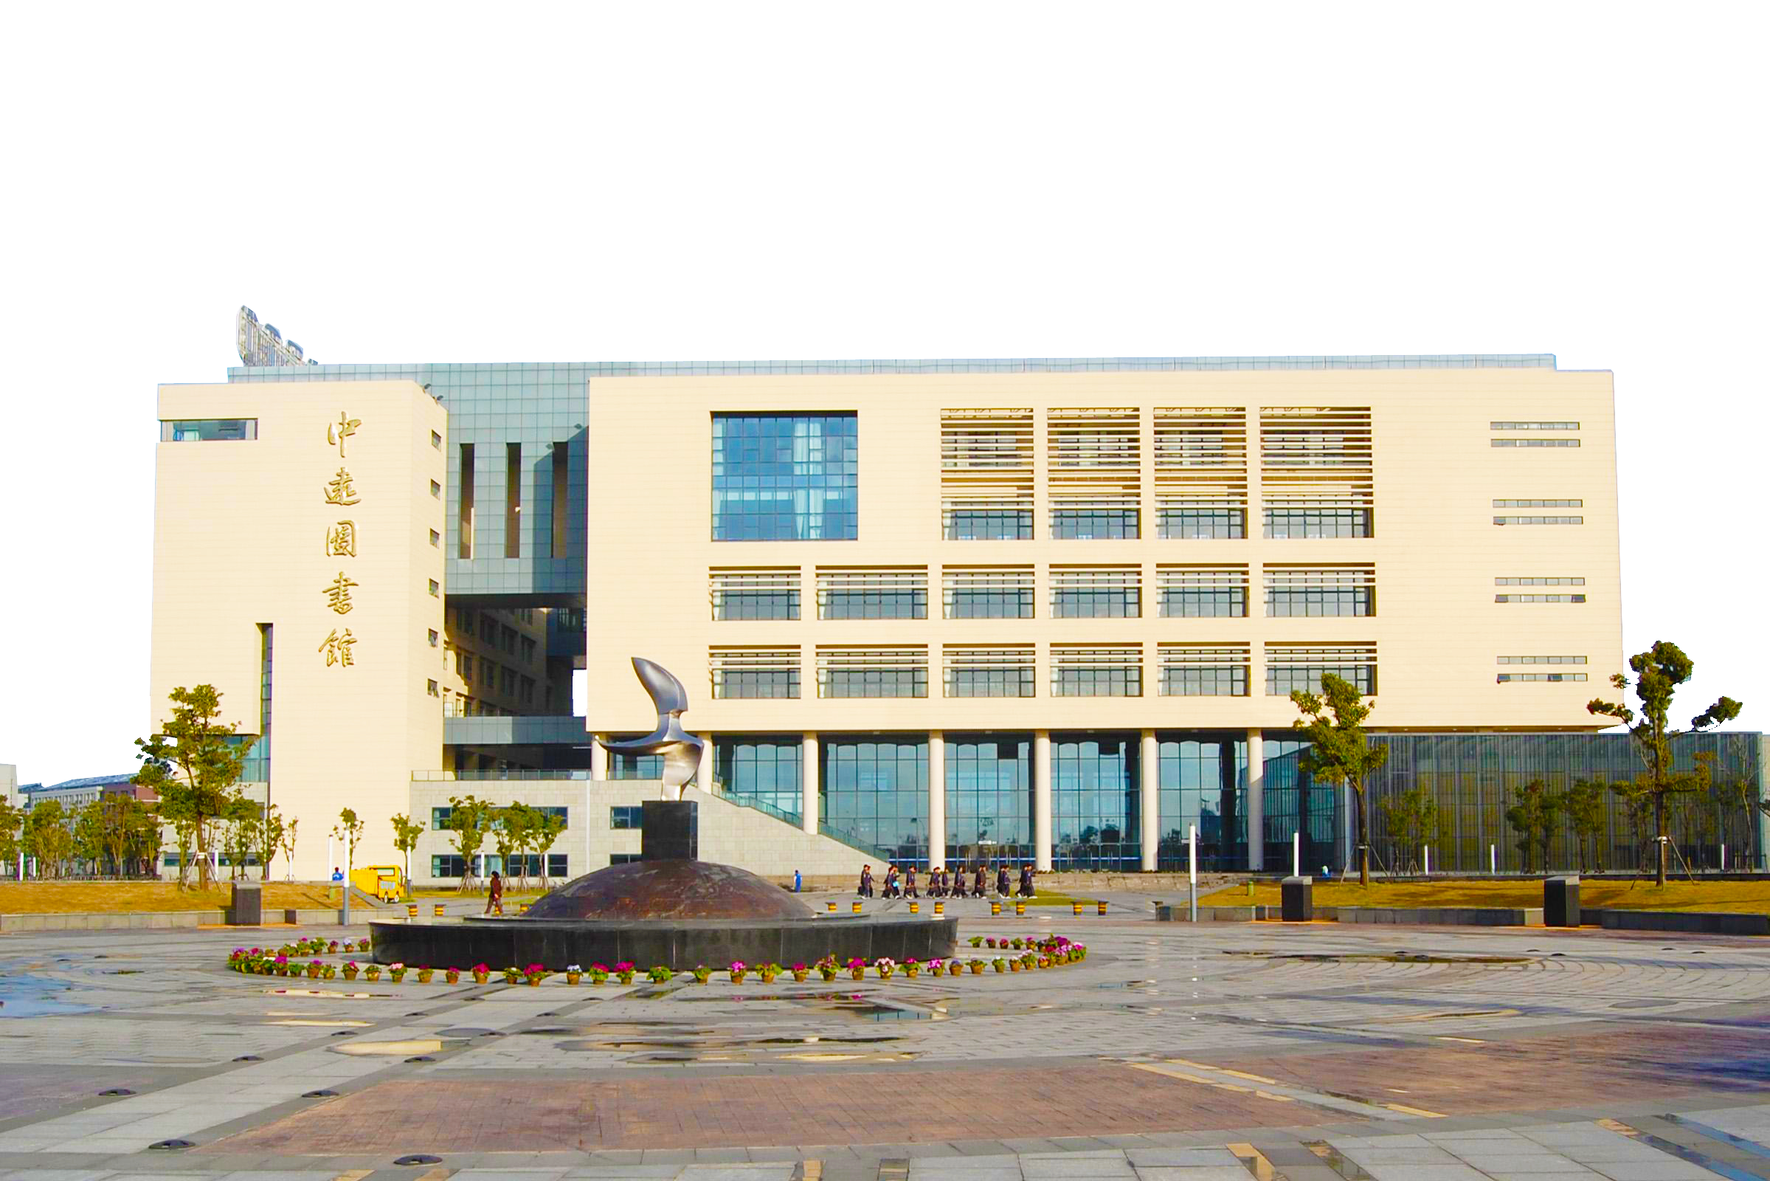
Part I
Purpose
At present, there are many seats in major university libraries, but there are still a large number of seats in short supply during the peak period of use. Occasionally, individual students may experience unpleasantness due to occupying behavior. Many students will also find a place to study and read a lot of time after a long search in the library, which greatly reduces the enthusiasm of the students.
At present, the library equipment is perfect, but the repair is not timely. It often happens that although there is a location, it is not properly used due to the damage of the hardware facilities.

Slide 4
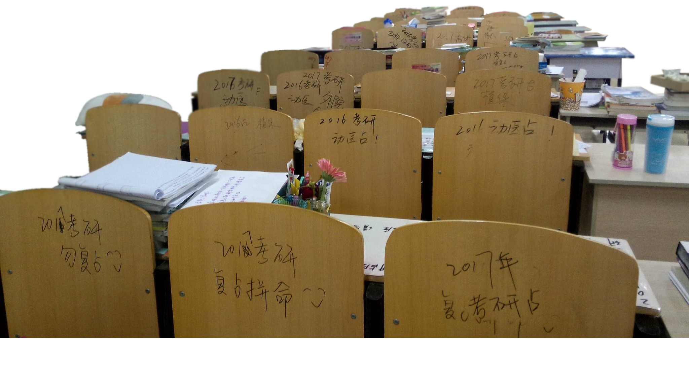
Hard to find a seat in the library
Imagine that when you transferred to the library, you found that many seats were occupied, but they were occupied.

Slide 5

Many seats have damaged
When you finally found an empty seat and found that the chair turned out to be broken.

Slide 6
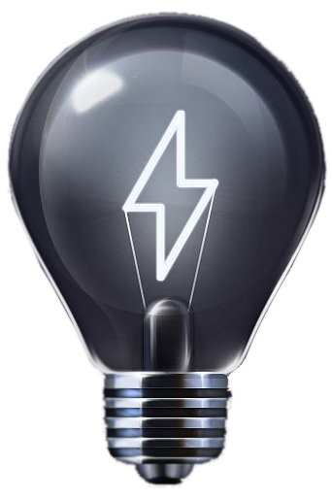
Smart Seat

Slide 7
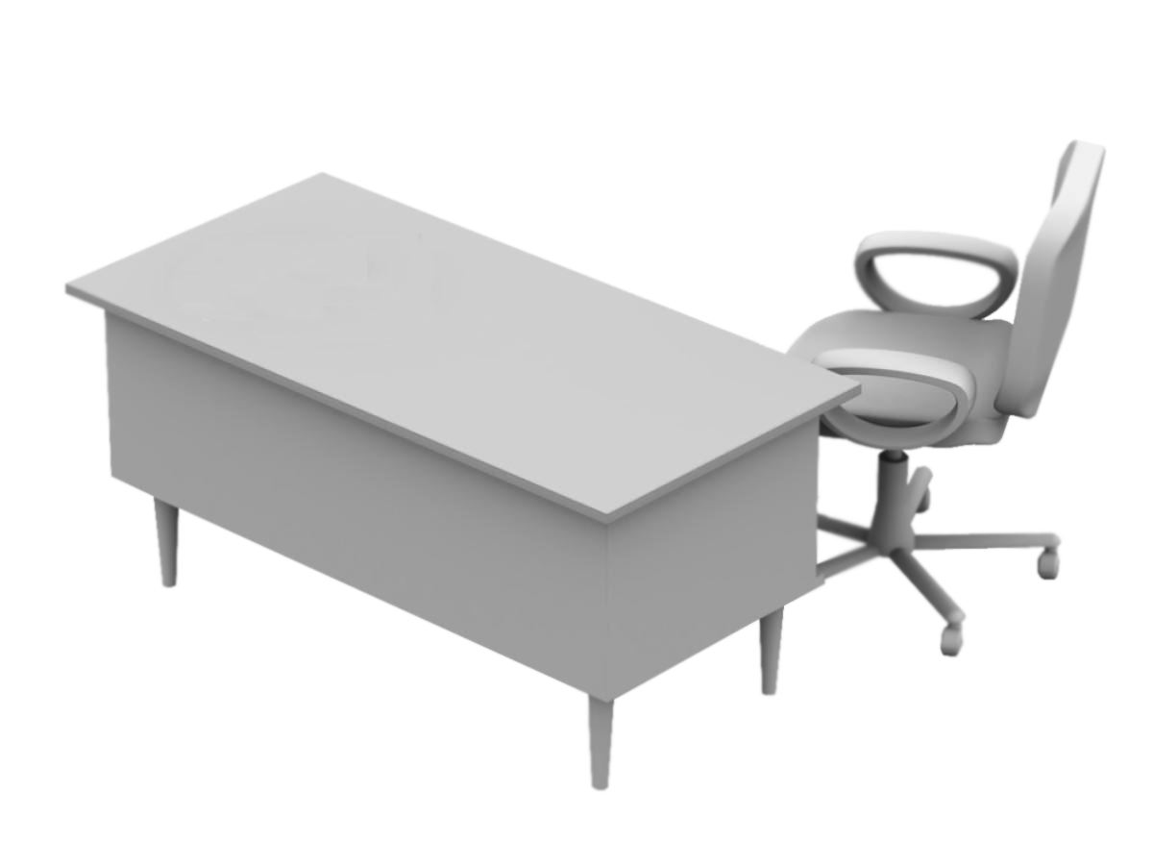
Part II
Concept Display
Smart Seat
V1
Reserve seat online
Automatically detect seat status
Report repair online

Slide 8
Part II
Concept Display
Indicate Light
PIR sensor
NodeMcu module

Slide 9
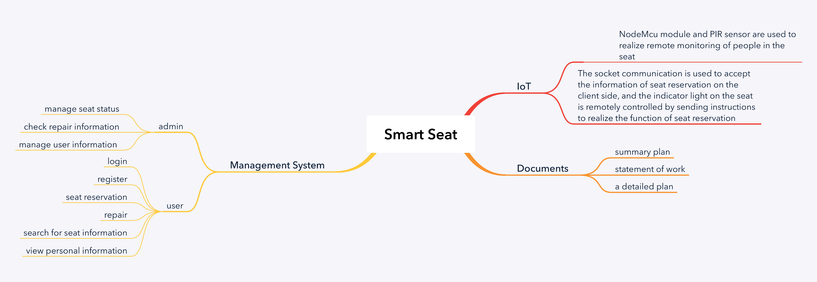
Part III
Summary Design

Slide 10
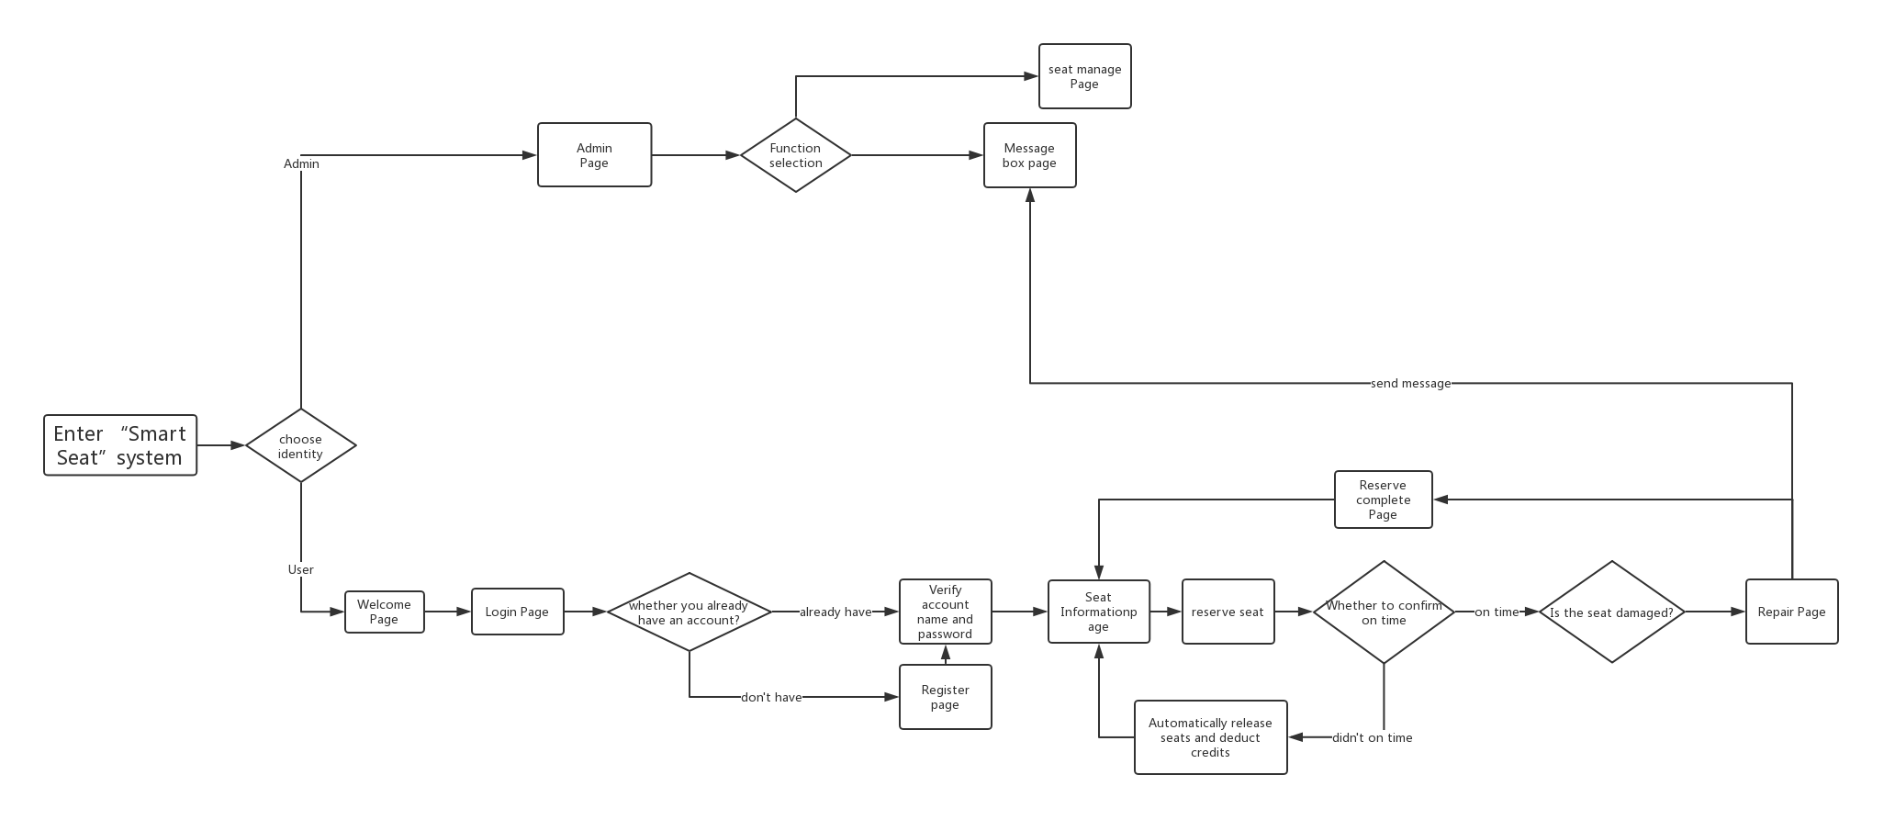
Part IV
Details Design

Slide 11



Supplement
A Question
Reserving Succeed！
But……
？？？

Slide 12
Smart
Seat
THANKS
for watching
Date：2019-03-18
Represented by：Hanyu Zhang

